Slide 1
JUnit and Mockito Training
May 2018

Slide 2
Content
Introduction to JUnit Framework
JUnit Example
Installing JUnit
Using JUnit
Running JUnit
Introduction to Mockito
Installing Mockito
Mockito Examples
Configuring Mocks
JUnit execution using Maven
Jenkins - Maven Integration

Slide 3
The JUnit Framework
JUnit is a test framework which uses annotations to identify methods that specify a test. JUnit is an open source project hosted at Github.
How to define a test is JUnit?
A JUnit test is a method contained in a class which is only used for testing. This is called a Test class. To define that a certain method is a test method, annotate it with the @Test annotation.
The method executes the code under test and check an expected result versus the actual result using assert statements.
JUnit naming conventions
There are several potential naming conventions for JUnit tests. A widely-used solution for classes is to use the "Test" suffix at the end of test classes names. The Maven build System automatically includes such classes in test scope.

Slide 4
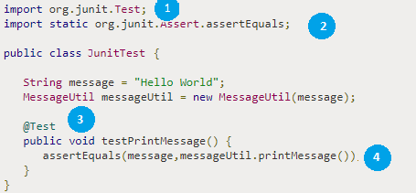
The JUnit Example
JUnit Example
No | Description
1 | Import Junit test library
2 | Import Junit assert library
3 | Add an Annotation @Test to method testPrintMessage().
4 | Implement the test condition and check the condition using assertEquals API of JUnit.

Slide 5
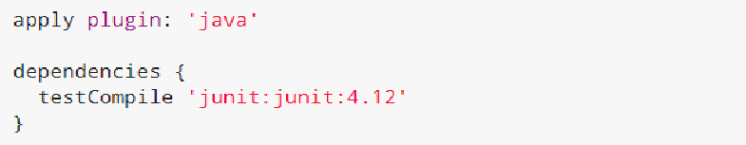
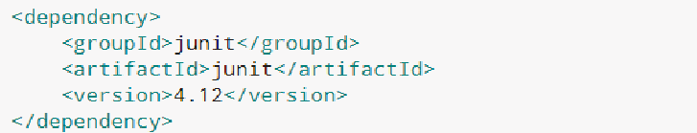
Installing JUnit
Using Gradle
To use JUnit in your Gradle build, add a testCompile dependency to your build file.
Using Maven
To use JUnit in your Maven build, add the following dependency to your pom file.

Slide 6
Using JUnit Framework
How to define test methods?
A JUnit uses annotations to mark methods as test methods and to configure them, following table gives an overview of most important annotations in JUnit for the 4.x and 5.x versions.
JUnit 4 | Description
import org.junit.* | Import statement for using the following annotations.
@Test | Identifies a method as a test method.
@Before | Executed before each test. It is used to prepare the test environment (e.g., read input data, initialize the class).
@After | Executed after each test. It is used to cleanup the test environment (e.g., delete temporary data, restore defaults). It can also save memory by cleaning up expensive memory structures.
@BeforeClass | Executed once, before the start of all tests. It is used to perform time intensive activities, for example, to connect to a database. Methods marked with this annotation need to be defined as static to work with JUnit.
@AfterClass | Executed once, after all tests have been finished. It is used to perform clean-up activities, for example, to disconnect from a database. Methods annotated with this annotation need to be defined as static to work with JUnit.

Slide 7
Using JUnit Framework
JUnit 4 | Description
@Ignore or @Ignore("Why disabled") | Marks that the test should be disabled. This is useful when the underlying code has been changed and the test case has not yet been adapted. Or if the execution time of this test is too long to be included. It is best practice to provide the optional description, why the test is disabled.
@Test (expected = Exception.class) | Fails if the method does not throw the named exception.
@Test(timeout=100) | Fails if the method takes longer than 100 milliseconds.

Slide 8
Using JUnit Framework
How to use Assert statements?
Assert statements allow you to specify the error message, the expected and the actual result. An assertion method compares the actual value returned by a test to the expected value. It throws an AssertionException if the comparison fails. The following table gives an overview of these methods.
Statement | Description
fail([message]) | Let the method fail. Might be used to check that a certain part of the code is not reached or to have a failing test before the test code is implemented. The message parameter is optional.
assertTrue([message,] boolean condition) | Checks that the boolean condition is true.
assertFalse([message,] boolean condition) | Checks that the boolean condition is false.
assertEquals([message,] expected, actual) | Tests that two values are the same. Note: for arrays the reference is checked not the content of the arrays.

Slide 9
Using JUnit Framework
Statement | Description
assertEquals([message,] expected, actual, tolerance) | Test that float or double values match. The tolerance is the number of decimals which must be the same.
assertNull([message,] object) | Checks that the object is null.
assertNotNull([message,] object) | Checks that the object is not null.
assertSame([message,] expected, actual) | Checks that both variables refer to the same object.
assertNotSame([message,] expected, actual) | Checks that both variables refer to different objects

Slide 10
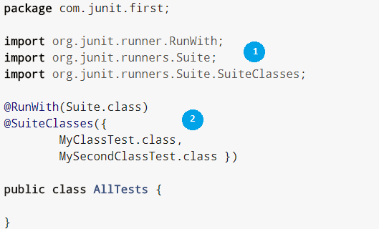
Using JUnit Framework
Using JUnit test suites
If you have several test classes, you can combine them into a test suite. Running a test suite executes all test classes in that suite in the specified order. A test suite can also contain other test suites. The following example code demonstrates the usage of a test suite
No | Description
1 | Imports JUnit Suite libraries
2 | Test Suite contains two test classes MyClassTest and MySecondClassTest. One can add more classes under @SuiteClasses

Slide 11
Using JUnit Framework
Disabling JUnit tests
The @Ignore annotation allow to ignore a test. Alternatively you can use Assume.assumeFalse or Assume.assumeTrue to define a condition for the test. Assume.assumeFalse marks the test as invalid, if its condition evaluates to true. Assume.assumeTrue evaluates the test as invalid if its condition evaluates to false. For example, the following disables a test on

Slide 12
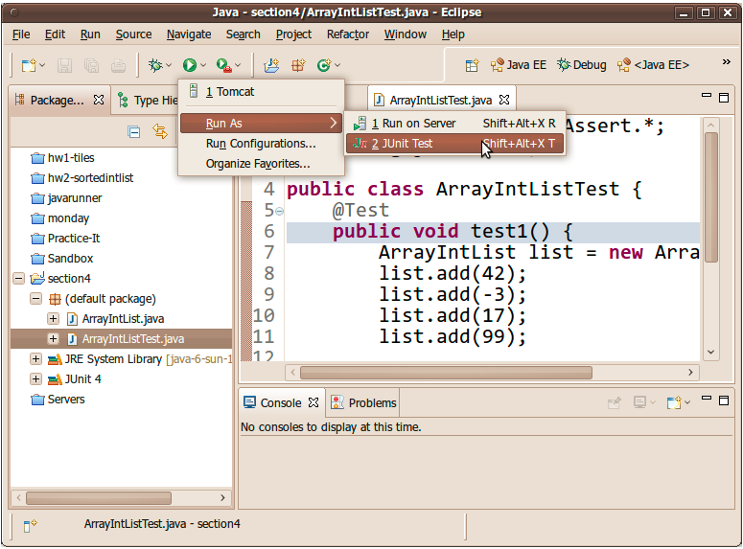
Running JUnits
To run a test using Eclipse IDE, select the test class, right-click on it and select Run-as ▸ JUnit Test
This starts JUnit and executes all test methods in the selected class. Results can be viewed under JUnit view.

Slide 13
Mockito Introduction
A unit test should test functionality in isolation. This can be done via using test replacements (test doubles) for the real dependencies. Test doubles can be passed to other objects which are tested. Your tests can validate that the class reacts correctly during tests. Test doubles can be classified like the following:
A dummy object is passed around but never used, i.e., its methods are never called. Such an object can for example be used to fill the parameter list of a method.
Fake objects have working implementations, but are usually simplified. For example, they use an in memory database and not a real database.
A stub class is an partial implementation for an interface or class with the purpose of using an instance of this stub class during testing. Stubs usually don’t respond to anything outside what’s programmed in for the test. Stubs may also record information about calls.
A mock object is a dummy implementation for an interface or a class in which you define the output of certain method calls. Mock objects are configured to perform a certain behavior during a test. They typical record the interaction with the system and test can validate that.
Mock objects typically require less code to configure and should therefore be preferred.

Slide 14
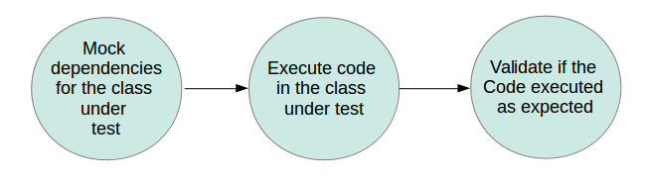
Mockito Introduction
Mockito is a popular mock framework which can be used in conjunction with JUnit. Mockito allows you to create and configure mock objects. Using Mockito simplifies the development of tests for classes with external dependencies significantly.
If you use Mockito in tests you typically:
Mock away external dependencies and insert the mocks into the code under test
Execute the code under test
Validate that the code executed correctly

Slide 15

Installing Mockito
Using Gradle
If you use Gradle in a Java project, add the following dependency to the Gradle build file.
Using Maven
To use Mockito in your Maven build, add the following dependency to your pom file.

Slide 16
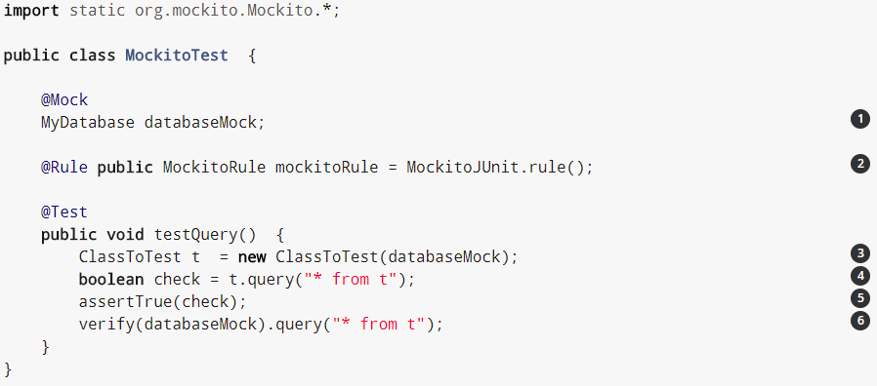
The Mockito Example
Mockito provides below methods to create mock objects:
Using the static mock() method.
Using the @Mock annotation.
If you use the @Mock annotation, you must trigger the creation of annotated objects. The MockitoRule allows this. It invokes the static method MockitoAnnotations.initMocks(this) to populate the annotated fields. Alternatively you can use @RunWith(MockitoJUnitRunner.class).

Slide 17
The Mockito Example
No | Description
1 | Tells Mockito to mock the databaseMock instance
2 | Tells Mockito to create the mocks based on the @Mock annotation
3 | Instantiates the class under test using the created mock
4 | Executes some code of the class under test
5 | Asserts that the method call returned true
6 | Verify that the query method was called on the MyDatabase mock

Slide 18
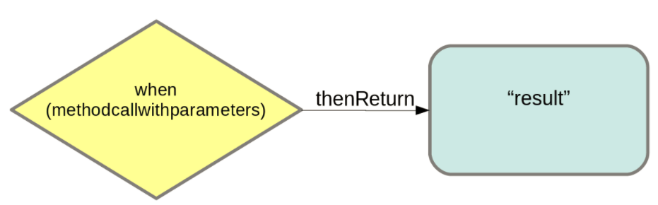
Configuring Mocks
Mocks can return different values depending on arguments passed into a method. The when(…​.).thenReturn(…​.) method chain is used to specify a return value for a method call with pre-defined parameters.
You also can use methods like anyString or anyInt matchers to define that dependent on the input type a certain value should be returned.
Please refer below link for more detail on matchers:
https://static.javadoc.io/org.mockito/mockito-core/1.9.5/org/mockito/Matchers.html

Slide 19
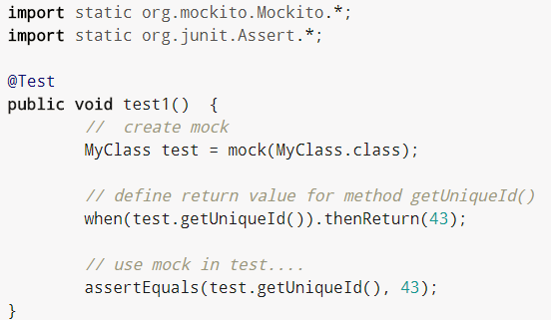
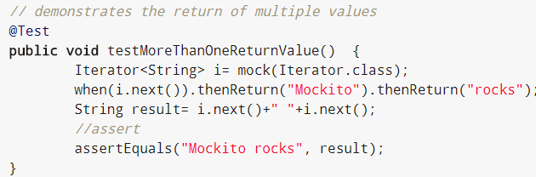
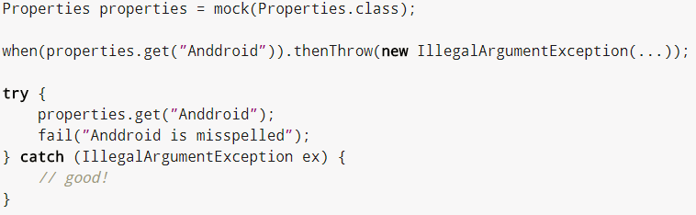
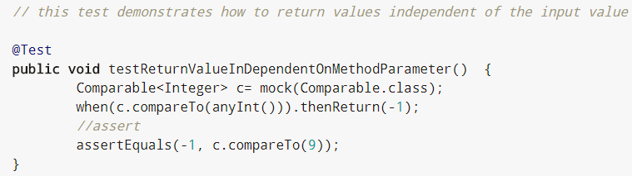
Example - Configuring Mocks - when(…​.).thenReturn(…​.)
The following demonstrates the usage of when(…​.).thenReturn(…​.):
// demonstrates when(…). thenThrow(…)

Slide 20
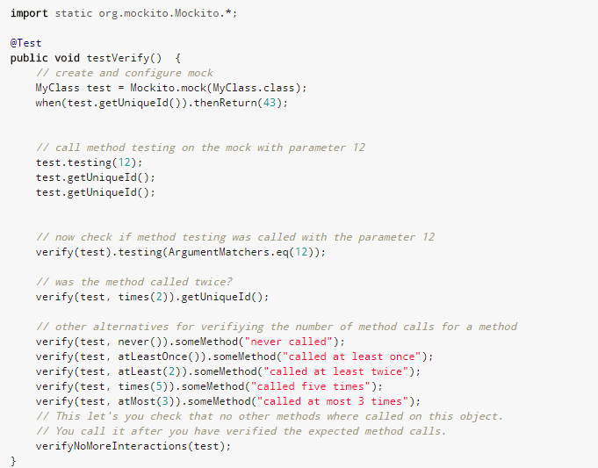
Example - Configuring Mocks - Verify
You can use the verify() method on the mock object to verify that the specified conditions are met.

Slide 21
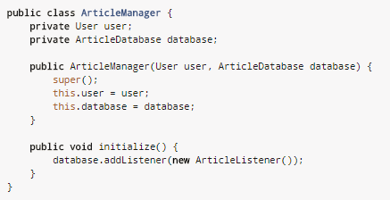
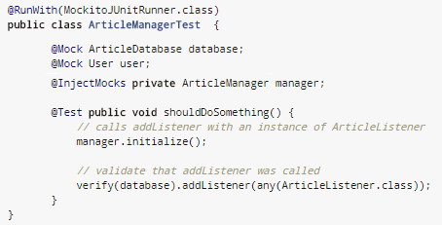
Example - Configuring Mocks - @injectMocks
You also have the @InjectMocks annotation which tries to do constructor, method or field dependency injection based on the type. For example, assume that you have the following class.
This class can be constructed via Mockito and its dependencies can be fulfilled with mock objects as demonstrated by above code snippet (right).
Mockito can inject mocks either via constructor injection, setter injection, or property injection and in this order. So if ArticleManager would have a constructor that would only take User and setters for both fields, only the mock for User would be injected.

Slide 22
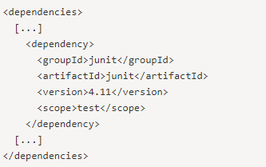
JUnit execution using Maven
To execute all of the unit tests in a project, include JUnit as a test scoped dependency in your project's pom.xml:
Your project should then store unit classes in the default location of ${basedir}/src/test/java.

Slide 23
Jenkins - Maven Integration
Jenkins will trigger the maven script which will execute JUnits (if it is configured in maven build script)
Follow below instructions to integrate maven with Jenkins:
In the Jenkins dashboard (Home screen), click Manage Jenkins from the left-hand side menu
Then, click on ‘Configure System’ from the right hand side.
In the Configure system screen, scroll down till you see the Maven section and then click on the ‘Add Maven’ button.
Add any name for the setting and the location of the MAVEN_HOME and click save.
You can now create a job with the ‘Maven project’ option. In the Jenkins dashboard, click the New Item option.

